Slide 1
Optics, guides
- Guides
Straight guide
Ballistic guide
Curved guide

Slide 2
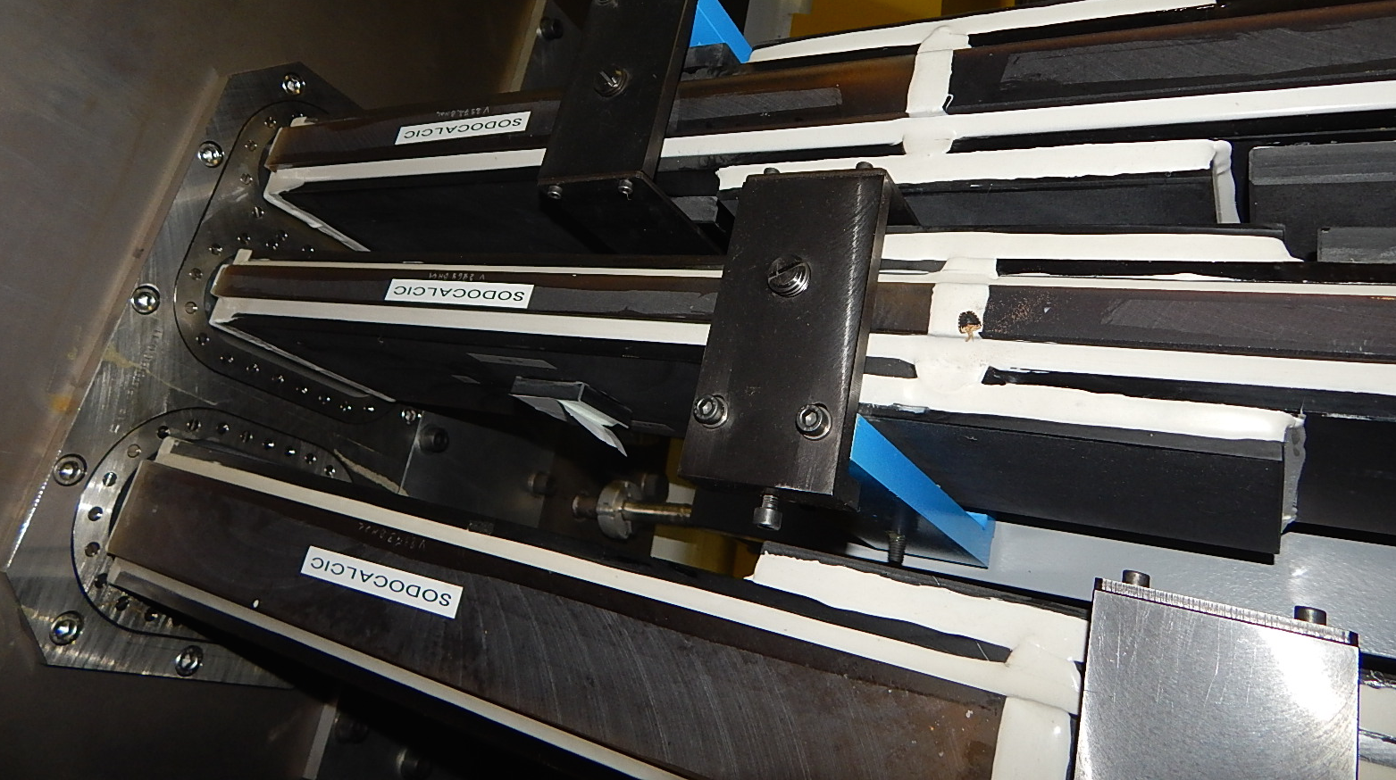
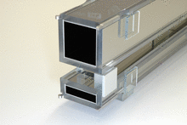
GUIDES
Neutron Transport
Source
Guide

Slide 3
STRAIGHT GUIDE
w1
h2
h1
w2
l

Slide 4
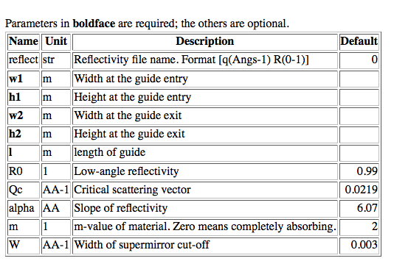
w1
h2
h1
w2
l

Slide 5
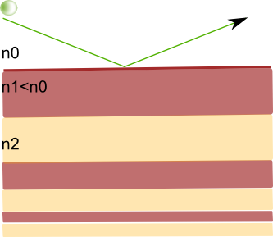
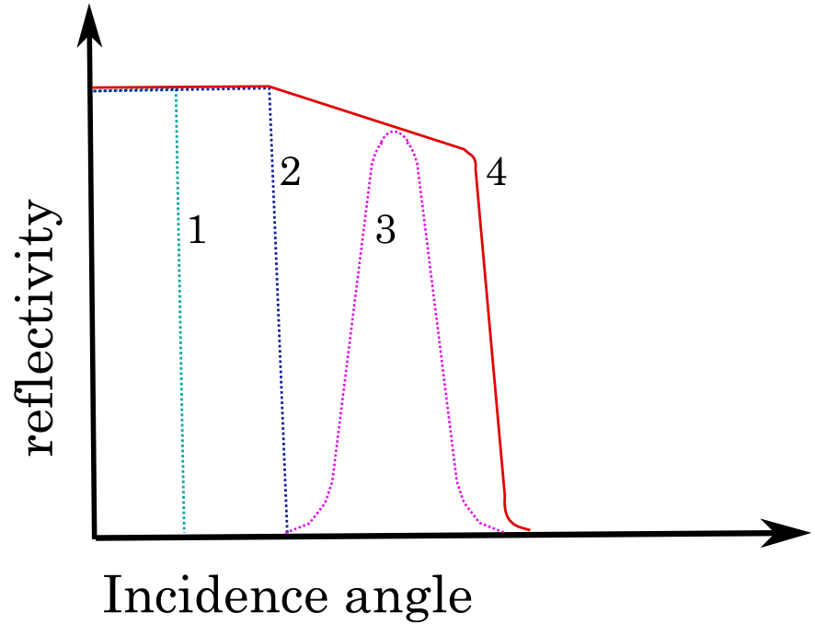
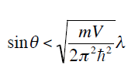
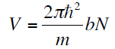
Supermirror Coating
d
R

Slide 6
w1
h2
h1
w2
l

Slide 7
Wanna try?

Slide 8
Ex_3_1_ballistic.instr
A simple, straight guide
Study the instrumentfile, notice use of the DECLARE and INITIALIZE sections
Notice the use of Source_gen to describe the PSI cold source
Notice the input parameter sa_pos, to vary the guide – sample position distance.
Insert a 30 m long guide at 3.5 meters from a1. Straight guide with a with of 5 cm an d height 15 cm.
Use R0=R0, Qc=Qc, alpha = alpha, m = M, W =W
Simulate

Slide 9
GUIDE DESIGN
Source
Guide

Slide 10
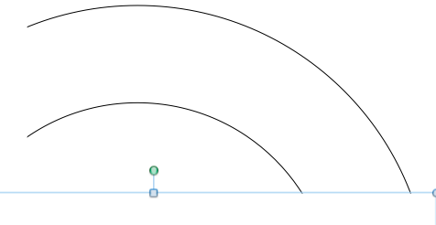
CURVED GUIDES
Getting out of direct line of sight
1 reflection per neutron mandatory to come out the other side of the guide

Slide 11
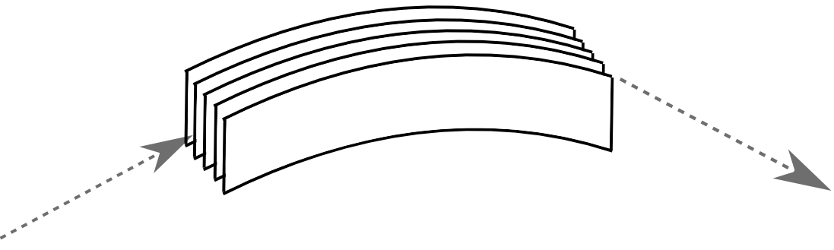
CURVED GUIDES
… in McStas
Use straight guides & rotation
Bender.comp
curvedGuide.comp

Slide 12
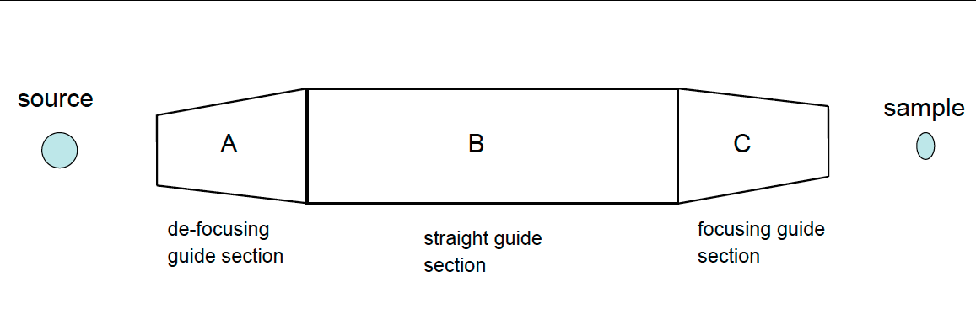
BALLISTIC GUIDE
Goal: high flux on sample

Slide 13
ELLIPTIC GUIDE
Few reflections - for transport loss in reflection cf next session
Focus on samples

Slide 14
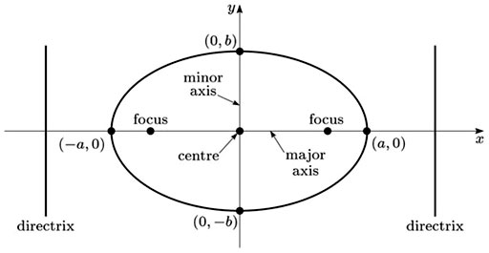
ELLIPTIC GUIDE
Elliptic_guide_gravity( l=50, linxw=5,linyh=5,loutxw=10,loutyh=10, xwidth=0.1,yheight=0.1, R0 = 0.99,Qc=0.0219,alpha=6.07,m=1.0,W=0.003, mvaluesright=marray,mvaluesleft=marray,mvaluestop=marray,mvaluesbottom=marray )

Slide 15
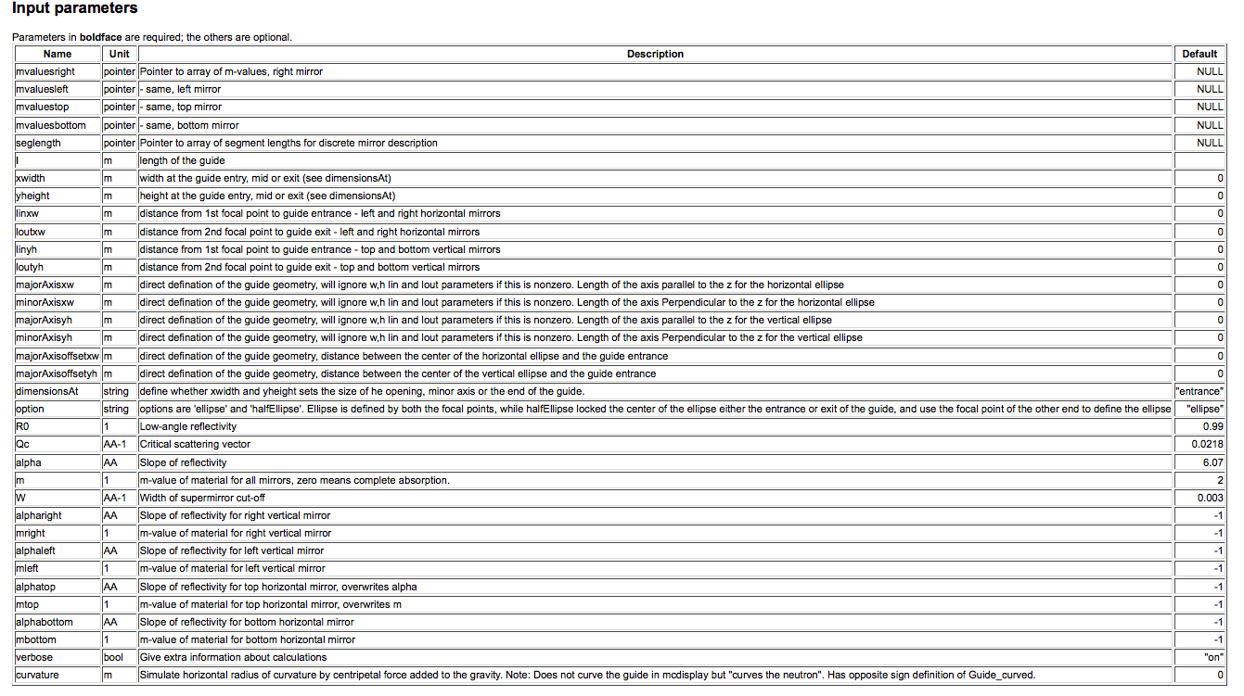
ELLIPTIC GUIDE
Gravity compatible
Define your geometry as is convenient to you
Chop the guide into segments
Define reflectivity for each side

Slide 16
OTHER McStas GUIDES
Elliptic_guide_gravity.comp
Guide_anyshape.comp
Guide_channeled.comp
Guide_curved.comp
Guide_four_side_10_shells.comp
Guide_four_side_2_shells.comp
Guide_four_side.comp
Guide_gravity.comp
Guide_honeycomb.comp
Guide_tapering.comp
Guide_wavy.comp
Guide.comp
Pol_guide_vmirror.comp
Have fun with elliptic guides
Add gravity to your simulation
Think of fantastic shapes and import their .OFF description
Curious? Lost? Need help?
Try $ mcdoc or visit http://mcstas.org/download/components

Slide 17
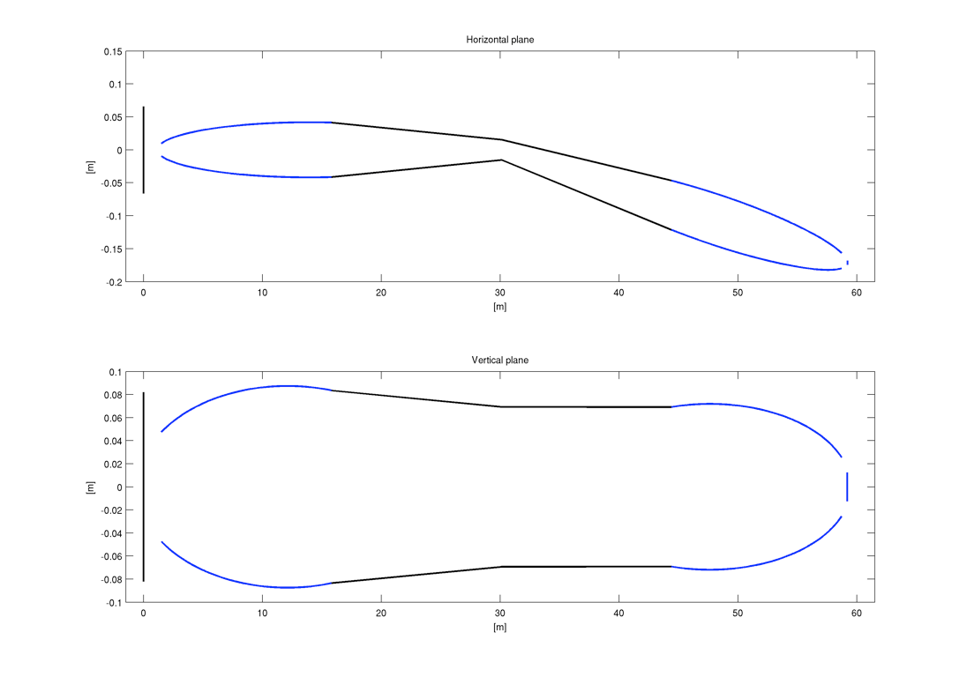
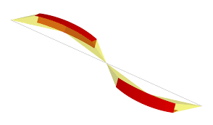
…stir and combine…

Slide 19
Optional: BALLISTIC GUIDE
Ex_3_2_ballistic.instr
1
2
3

Slide 20
Optional: BALLISTIC GUIDE
Open the instrumentfile Ex_3_1_ballistic.instr
Look at guide2. What exit(entry) dimensions do guide1 & 3 need?
Insert guide1 with an entry opening of w1=0.03m, h1=0.1m, length 3 m at 0.5m from a1
Insert guide3 with an exit opening of w2=0.03, length 3 m at 33.5m from a1
For both guides, use the coating parameters from guide2

Slide 21
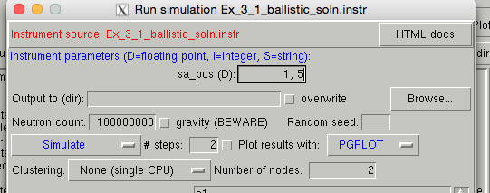
SCAN FUNCTION
Give the interval to be scanned directly in the parameter position in the form lower_lim, upper_lim
Indicate the number of steps

Slide 22
Optional: BALLISTIC GUIDE
Compile and TRACE to have an overview of the instrument.
Run a simulation and notice the wavelength distribution before and after guide.
Task: Scan sa_pos between 0 and 1 m in 11 steps. Notice the effect on beam profiles and divergence.

Slide 24
CURVED GUIDES
… in McStas
Use straight guides & rotation
Bender.comp
curvedGuide.comp

Slide 25
CURVED GUIDES
Open the instrument file Ex_3_2_curved.instr given to you
Study the instrument file, notice use of the PREVIOUS keyword
Notice input parameters of guide m-value, angular rotation of guide segments
Question: What is the relevant rotation angle to achieve a guide curvature of 1 km?
Try performing a TRACE
Try varying the guide curvature, notice effect on divergence and beam profile
Other curved guides:
Use McDoc -> Component Library Index to look at Guide_curved plus Bender from the McStas lib

Slide 27
w
R
R
R

